Slide 1
Probability Distribution Types
Discrete
Uniform
Binomial
Poisson
Continuous
Uniform*
Exponential
Normal

Slide 2
Discrete Distributions: (1) Uniform Distribution
Note: Uniform Distribution can also fall under continuous probability distributions category, depending on what we are measuring. If the observations are not discrete, a uniform distribution becomes continuous.
Uniform Discrete Distribution: Throw of a dice (exactly 1, 2, …, 6)
Uniform Continuous Distribution: Time taken by a flight (can go up to nano seconds and beyond)

Slide 3
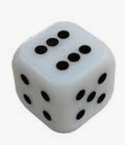
Uniform Distribution
Rolling a fair die has 6 discrete, equally probable outcomes
We can roll a 1 or 2, but not 1.5
The probabilities of each outcome are evenly distributed across the sample space

Slide 4
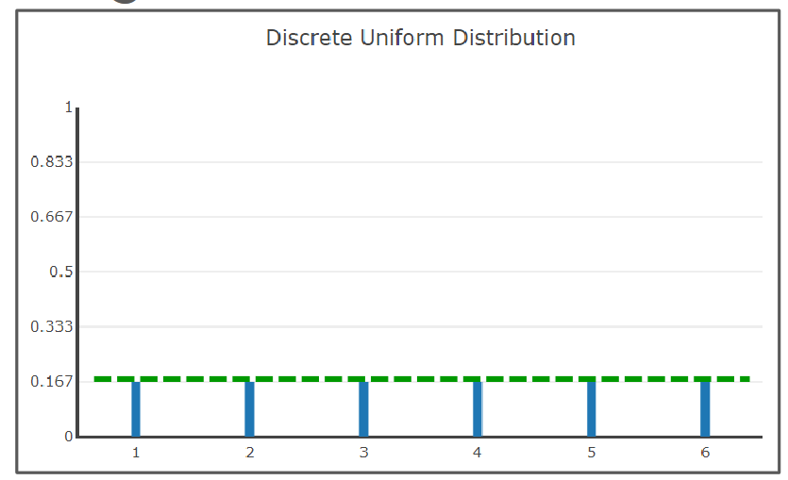
Uniform Distribution
Rolling a die has 6 equal probabilities and their total adds to 1
X-axis: Values
Y-axis: Probabilities

Slide 5
Discrete Distributions: (2) Binomial Distribution

Slide 6
Binomial Distribution
Binomial variable: A variable that can take on one of two possible values
Example: Heads or Tails, On or Off, Sick or Healthy
The two outcomes do not always have to be equally probable
Example: In a fruit basket, there are 7 apples and 3 oranges
P(A) = 7/10, P(O) = 3/10
Called Bernoulli Trial: A random experiment in which there are only two outcomes – success or failure

Slide 7
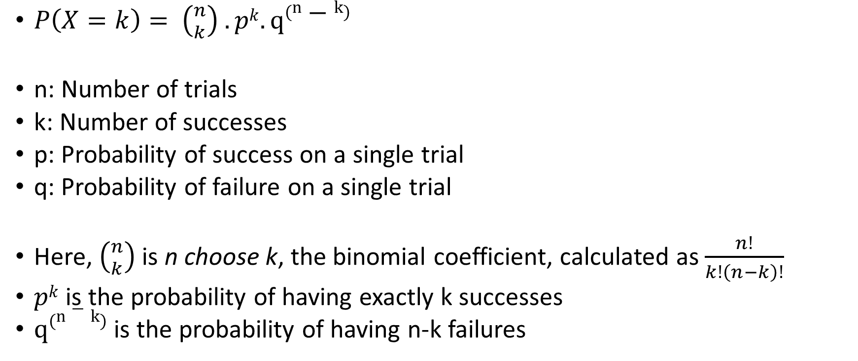
Binomial Probability Mass Function
Example: To find the probability of getting 2 heads in 5 coin tosses (assuming a fair coin with p = 0.5 for heads), n = 5, k = 2, and p = 0.5 into the formula
Probability = 0.3125 or 31.25%
$P\left(X=k\right)= \left({n \atop k}\right) .pk. q\left(n−k\right)$
n: Number of trials
k: Number of successes
p: Probability of success on a single trial
q: Probability of failure on a single trial
Here, $\left({n \atop k}\right)$ is n choose k, the binomial coefficient, calculated as $\frac{n!}{k!\left(n−k\right)!}$
$pk$ is the probability of having exactly k successes
$q\left(n−k\right)$ is the probability of having n-k failures

Slide 8
Example
Suppose a factory produces light bulbs, and historically, 5% of the bulbs are defective. The quality control team randomly selects 10 bulbs for testing. What is the probability that exactly 2 of them are defective?
n = Number of bulbs tested = 10
k = Number of defective bulbs = 2
p = Probability that a bulb is defective = 0.05
q = 1 – p = 0.95 = Probability that a bulb is not defective

Slide 9
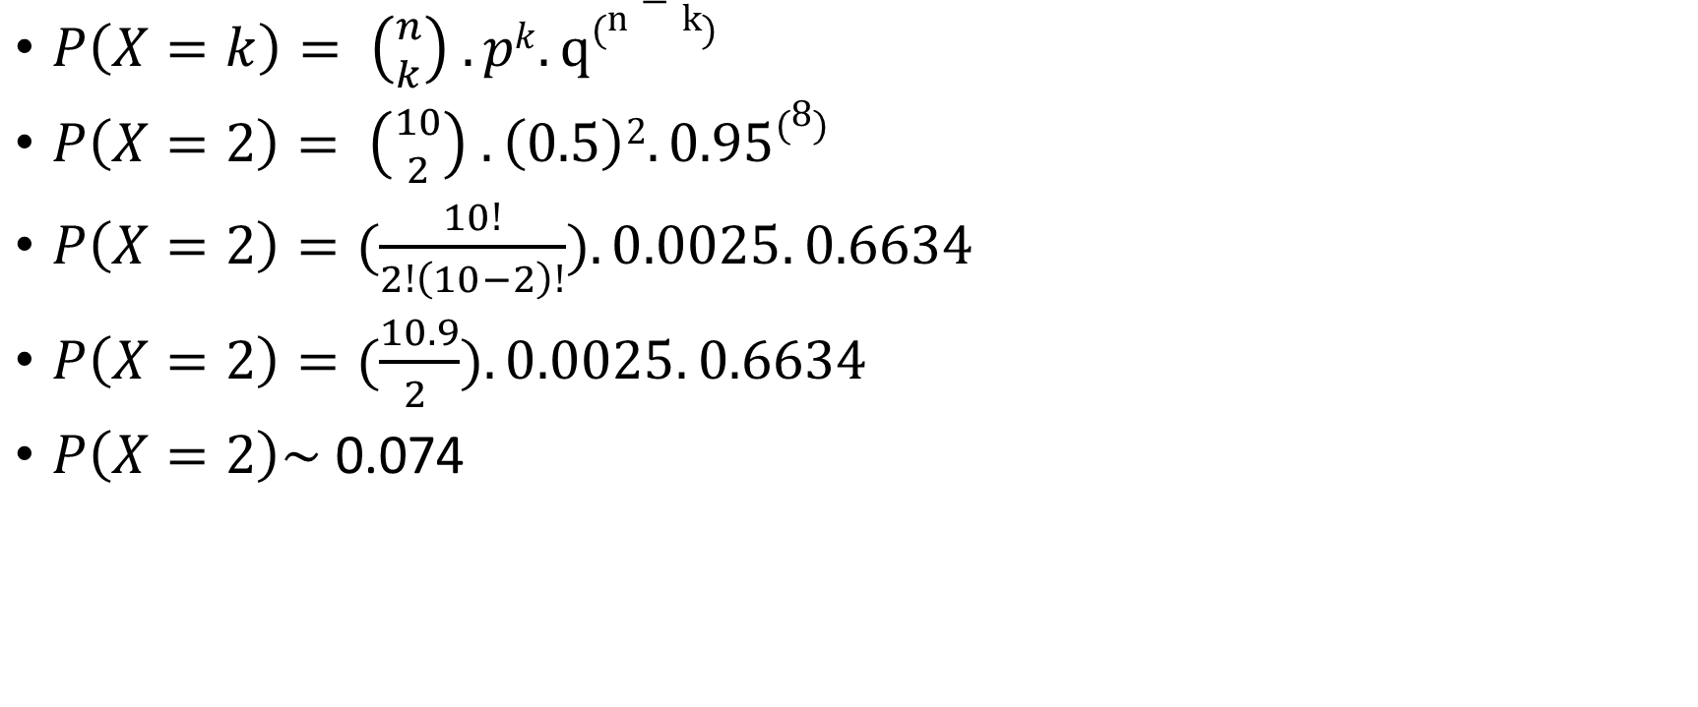
Solution
$P\left(X=k\right)= \left({n \atop k}\right) .pk. q\left(n−k\right)$
$P\left(X=2\right)= \left({10 \atop 2}\right) .\left(0.5\right)2. 0.95\left(8\right)$
$P\left(X=2\right)=(\frac{10!}{2!\left(10−2\right)!}).0.0025. 0.6634$
$P\left(X=2\right)=(\frac{10.9}{2 }).0.0025. 0.6634$
$P\left(X=2\right)\sim$ 0.074

Slide 10
Discrete Distributions: (3) Poisson Distribution

Slide 11
Poisson Distribution
Binomial distribution: Perform n trials and determine success/failure
Poisson distribution: Considers the number of successes per unit of time (or another continuous unit, such as distance)
Example: Usually 15 cars pass a toll plaza every hour. We want to know the probability that 13 cars will pass through in the next hour.

Slide 12
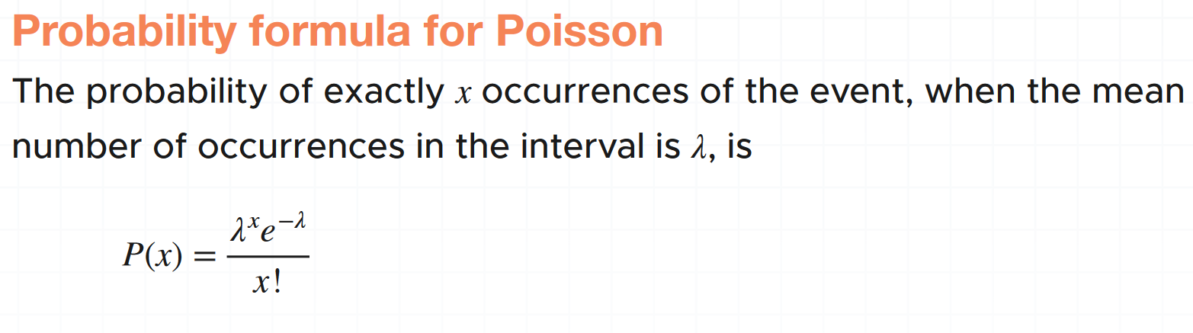
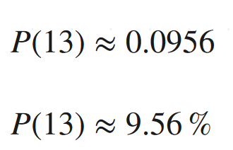
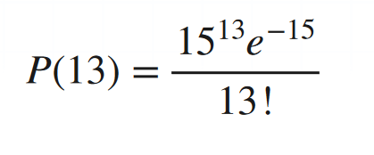
Poisson Distribution – Example
Example: Usually 15 cars pass a toll plaza every hour. We want to know the probability that 13 cars will pass through in the next hour.
Conclusion: 9.56% chance of 13 cars passing in the next hour
Note: e = 2.718, Euler's constant

Slide 13
Poisson Distribution – Another Example
A food delivery joint typically receives 8 deliveries between 4 and 5 pm on Fridays. What is the probability that only 4 deliveries will be received coming Friday?

Slide 14
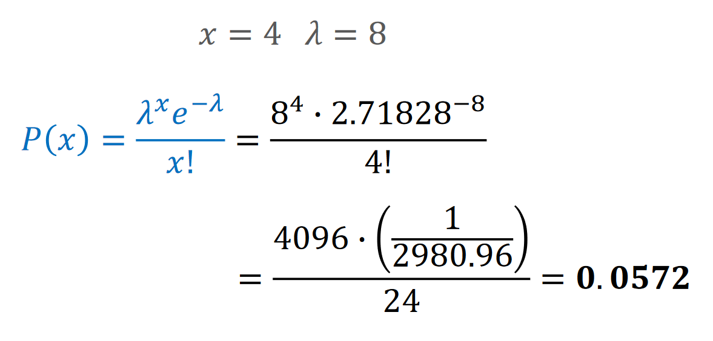
Poisson Distribution – Another Example
A food delivery joint typically receives 8 orders between 4 and 5 pm on Fridays. What is the probability that only 4 orders will be received coming Friday?

Slide 15
Continuous Distributions: Normal Distribution

Slide 16
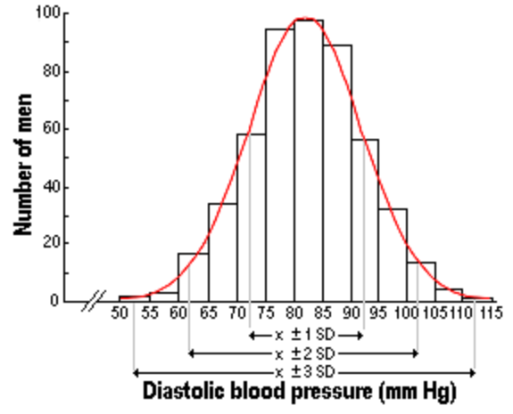
Real life and Normal Distribution
Many real-life data points follow Normal Distribution:
People’s heights and weights
Population blood pressure
Test scores
Also called as Gaussian Distribution
Generally, less/non-natural phenomena do not have normal distributions, e.g. income of people

Slide 17
Normal Distribution, Bell Curve …
In the US, a baby is just born with weight of 2.91 kg
The mother is told that the baby’s weight is below average and hence she is concerned
Is the weight unusually low?
We can use the population distribution, which is the pattern of all the babies born in a particular year in the US
We can then compare the weight of the newly born baby to see whether it is low, and if yes, by how much?

Slide 18
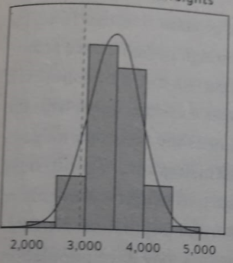
Distribution of over 1 Million Babies’ Birth Weights
X-axis denotes the weight in grams
The current baby’s weight is the dotted line
Its position in the distribution can be used to assess whether it is unusual
The shape of this distribution is important – called normal distribution or bell curve

Slide 19
Characteristics of Normal Distribution
Uses only two things: Mean and Standard deviation
In our example, the mean is 3480 grams and standard deviation is 462 grams
How can we use this information?

Slide 20
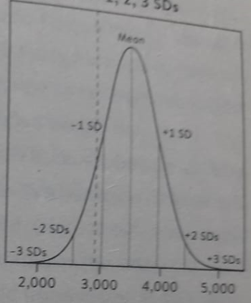
Use of Mean and Standard Deviation
Now we see the position of the mean and 1, 2, and 3 standard deviations each side of the mean
From the mathematical properties of the normal distribution, roughly 95% population will be within mean ± two SDs and 99.8% within mean ± three SDs
The new baby is 1.2 SDs below mean (why? See next slide), which is her Z-score (which measures how many SDs away a data point from the mean)

Slide 21
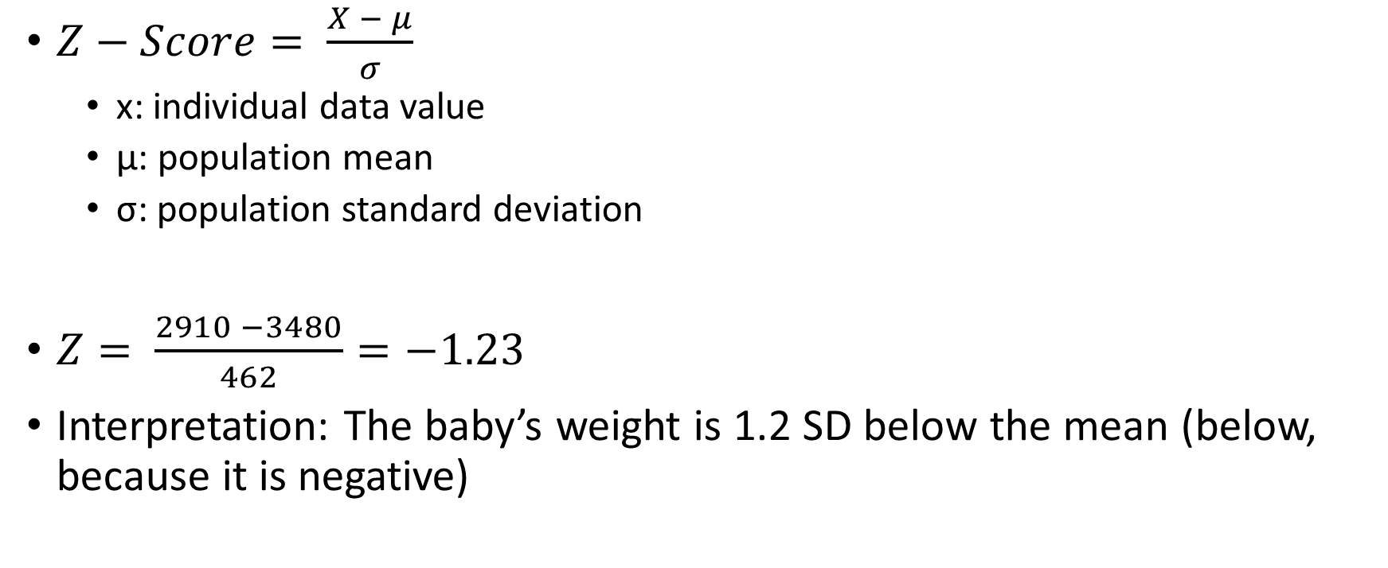
Why is the Baby 1.2 SD below the Mean?
$Z−Score= \frac{X − μ}{σ}$
x: individual data value
μ: population mean
σ: population standard deviation
$Z= \frac{2910 −3480}{462}=−1.23$
Interpretation: The baby’s weight is 1.2 SD below the mean (below, because it is negative)

Slide 22
Shapiro Test (C:\code\Data Analytics\normal-distribution-shapiro.py)
Shapiro-Wilk Test tells if our data sample comes from a normally distributed population
It arranges all data points in an ascending order and subtracts mean from each data point
Then it divides the data by standard deviation
This transforms the data to a standard normal distribution with a mean of 0 and standard deviation of 1
It then looks at the various quantiles (e.g. Q1, Q2, Q3) of the data and compares them with the expected values for normal distribution
It then uses the p-value (discussed separately) to make a conclusion

Slide 23
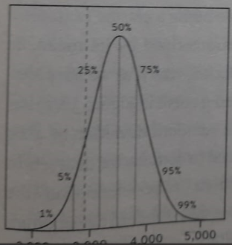
Percentiles and Quartiles
Percentile: That percentage of data is less than the point at which we are
The 50th percentile is the median – the weight of the average baby
The 25th percentile (3167 grams) is the weight under which 25% of the babies lie ~ Quartile 1
The 75th percentile (3791 grams) is the weight under which 75% of the babies lie ~ Quartile 3
Inter Quartile Range (IQR) = 3791 – 3167 = 624 grams

Slide 24
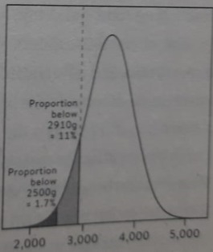
Interpreting the new baby’s weight
The new baby’s weight lies on the 11th percentile (Why? See next slide)
This means that 10% babies born had weight lesser than her

Slide 25
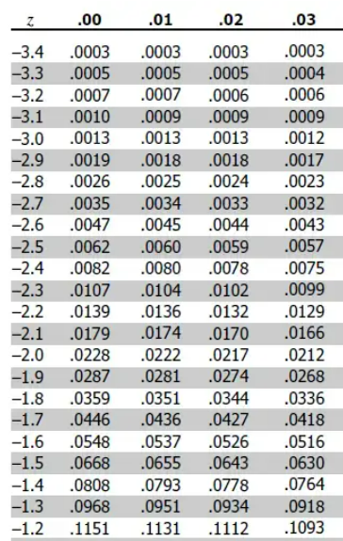
Using Z-Score
We know the Z-score for the current baby: -1.23
Go to Z-table (https://www.z-table.com/)
Look for -1.2 in row and 3 in column
Interpretation: ~10% babies have lesser weight
So, this baby is in the 11th percentile

Slide 26
Normal Distributions and Empirical Rule
Normal distributions follow the empirical rule, also called the 68-95-99.7 rule
The rule tells us that, for a normal distribution, there’s a
68% chance that a data point falls within 1 standard deviation of the mean
95% chance that a data point falls within 2 standard deviations of the mean
99.7% chance that a data point falls within 3 standard deviations of the mean

Slide 27
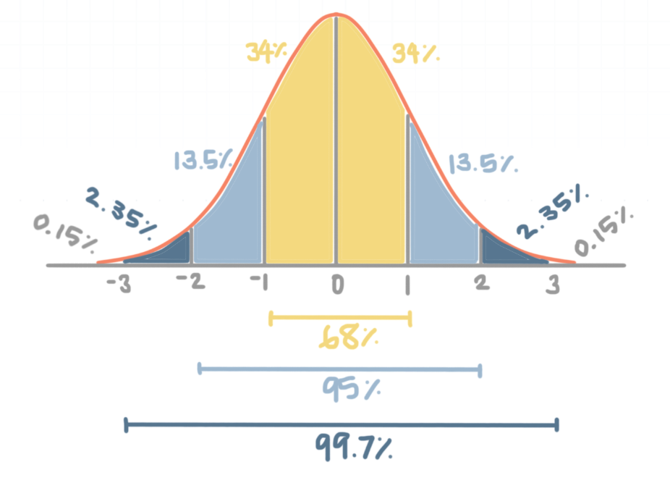
Use of this rule

Slide 28
Example
For CDAC C-CAT (300 marks test), the population average score 𝜇 is 170 and standard deviation is 𝜎 = 30.
A student has got 250 marks
Which minimum percentile is she in?
Mean = 170
SD = 30
Mean + 2 SD = 170 + 60 = 230 (95% of the population)
Mean + 3 SD = 170 + 90 = 260 (99.7% of the population)
So, the student is between 95th and 99.7th percentile
She is definitely in the top 5%, and close to top 1%

Slide 29
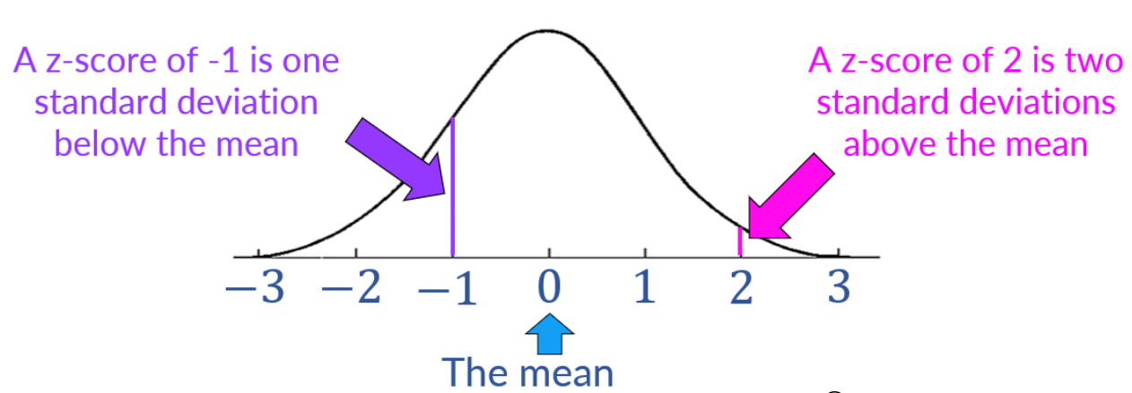
Z-Score
Z-scores > +3 and < -3 are considered outliers
The Z-Score describes how many standard deviations away a data point is from the mean

Slide 30


Z-Score Example
A runner participated in a 200m race and a 500m race
Consider the following and determine where she did better
Race | Average time | Standard deviation | Runner’s time
200m | 31s | 1.5s | 28s
500m | 125s | 8.2s | 132s
200m
$$Z= \frac{X − μ}{σ}=\frac{28 −31}{1.5}=−2$$
500m
$$Z= \frac{X − μ}{σ}=\frac{132 −125}{8.2.}=0.854$$

Slide 31
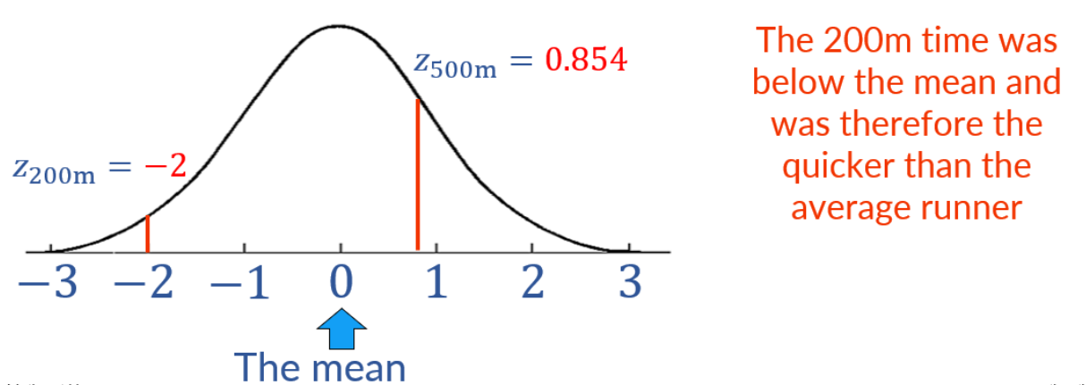
Visualizing Z-Scores
In other examples, positive/higher Z-score will be better, e.g. marks obtained by a student – Because, here the student would want to be above average
In this example, a lower time would be preferable when completing a race and so, the lower z-score would be better

Slide 32
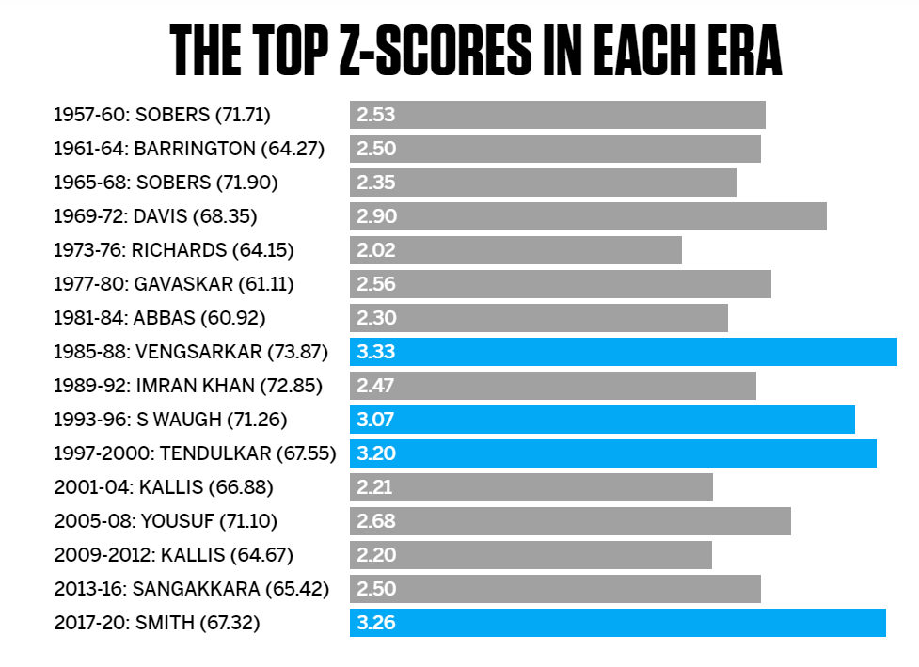
Z-Score Example

Slide 33
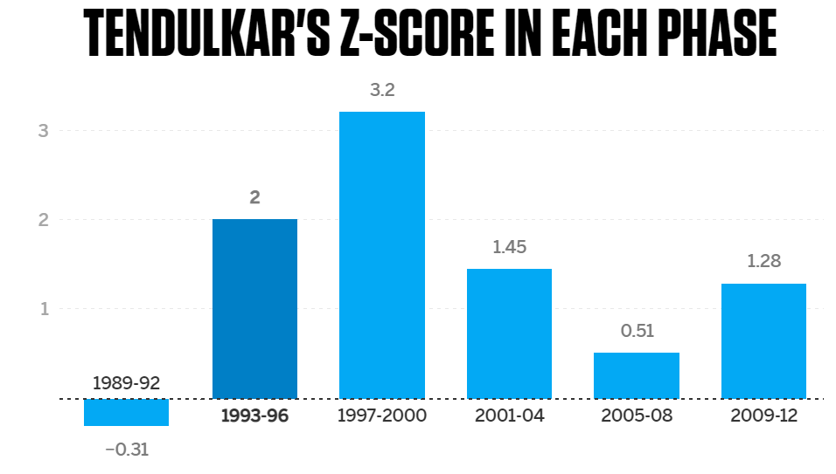
Z-Score Example

Slide 34
Usefulness of Z-Scores
Z-scores give us an idea of how an individual value compares to the rest of a distribution
Example: Is an exam score of 87 good?
If the exam scores for the whole population are normally distributed with a mean of 90 and a standard deviation of 4, we would calculate the z-score for 87 as:
z = (X – μ) / σ = (87 – 90) /4 = -0.75
Since this value is negative, it tells us that an exam score of 87 is actually below the average exam score for the population
An exam score of 87 is 0.75 standard deviations below the mean

Slide 35
Using Z-Table
The z-table provides the cumulative probability of a test value below or above a specific z-score
Suppose you have student marks following normal distribution with mean = 75 and SD = 10
# | Situation | Important points | Z-Score | Action
1 | Find the probability that a randomly selected student scored < 80 marks | Test value > mean (80 > 75) We are testing Test value < something | Positive | None
2 | Find the probability that a randomly selected student scored < 50 marks | Test value < mean (50 < 75) We are testing Test value < something | Negative | None
3 | Find the probability that a randomly selected student scored > 80 marks | Test value > mean (80 > 75) We are testing Test value > something | Positive | 1 – Result
4 | Find the probability that a randomly selected student scored > 45 marks | Test value < mean (45 < 75) We are testing Test value > something | Negative | 1 - Result
Why 1 – Result in the last two cases? Because Z-table gives cumulative probability that a random variable is <= a given Z-score. So, if we are looking for a random variable that is > a given Z-score, we need to subtract the resulting probability from 1

Slide 36
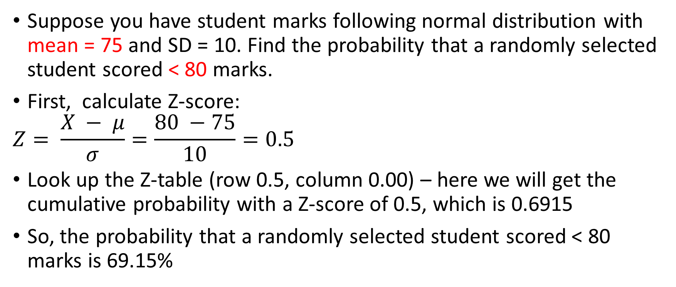
Z-table: Case 1
Suppose you have student marks following normal distribution with mean = 75 and SD = 10. Find the probability that a randomly selected student scored < 80 marks.
First, calculate Z-score:
$$Z= \frac{X − μ}{σ}=\frac{80 −75}{10}=0.5$$
Look up the Z-table (row 0.5, column 0.00) – here we will get the cumulative probability with a Z-score of 0.5, which is 0.6915
So, the probability that a randomly selected student scored < 80 marks is 69.15%

Slide 37
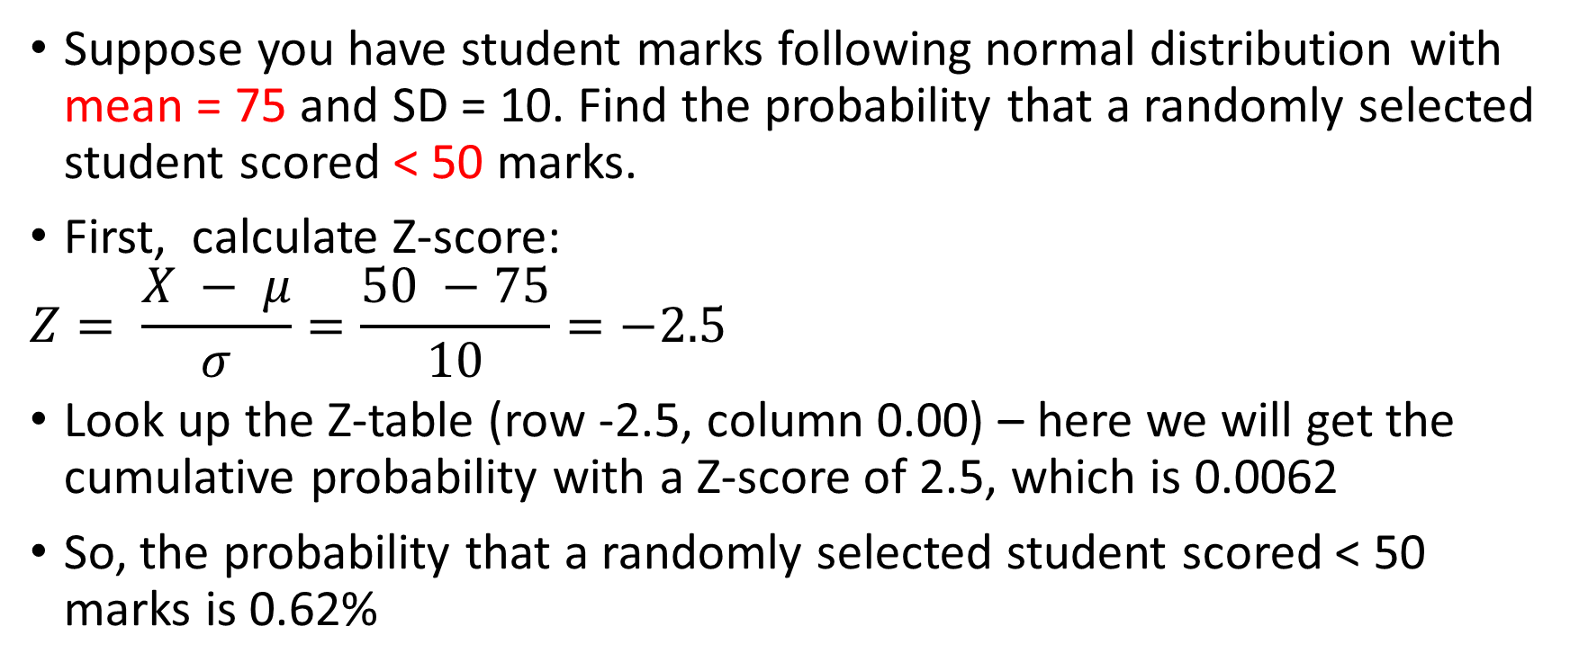
Z-table: Case 2
Suppose you have student marks following normal distribution with mean = 75 and SD = 10. Find the probability that a randomly selected student scored < 50 marks.
First, calculate Z-score:
$$Z= \frac{X − μ}{σ}=\frac{50 −75}{10}=−2.5$$
Look up the Z-table (row -2.5, column 0.00) – here we will get the cumulative probability with a Z-score of 2.5, which is 0.0062
So, the probability that a randomly selected student scored < 50 marks is 0.62%

Slide 38
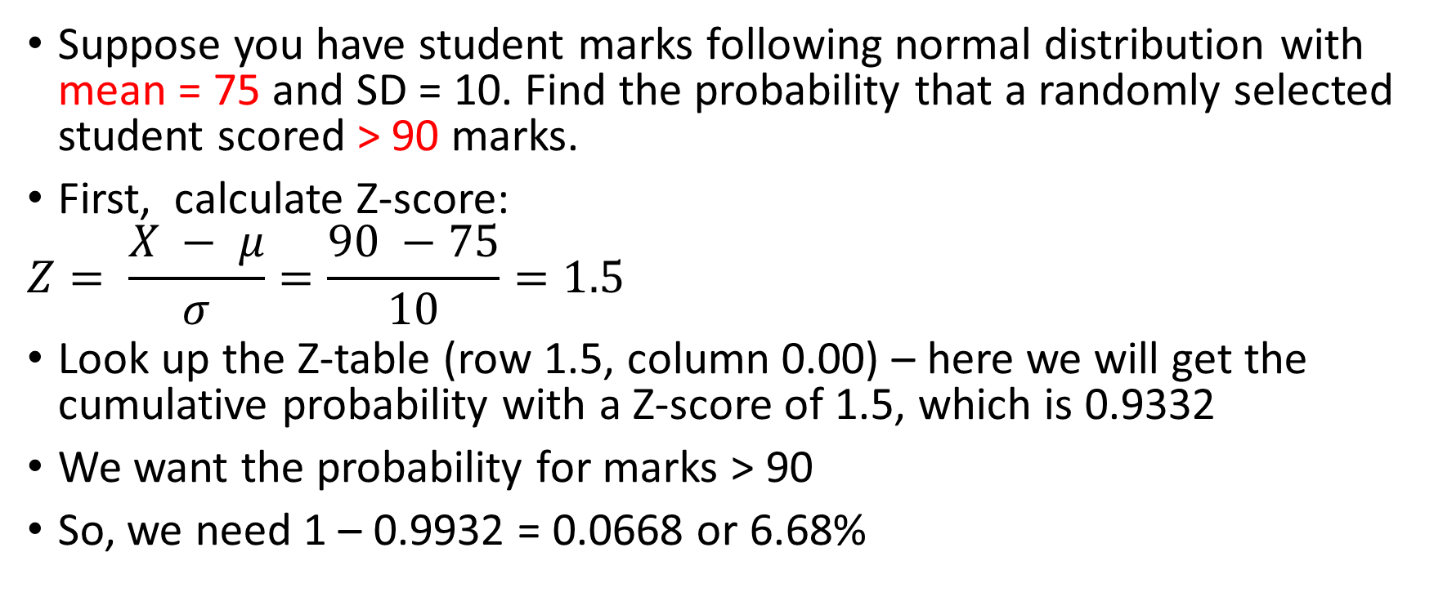
Z-table: Case 3
Suppose you have student marks following normal distribution with mean = 75 and SD = 10. Find the probability that a randomly selected student scored > 90 marks.
First, calculate Z-score:
$$Z= \frac{X − μ}{σ}=\frac{90 −75}{10}=1.5$$
Look up the Z-table (row 1.5, column 0.00) – here we will get the cumulative probability with a Z-score of 1.5, which is 0.9332
We want the probability for marks > 90
So, we need 1 – 0.9932 = 0.0668 or 6.68%

Slide 39
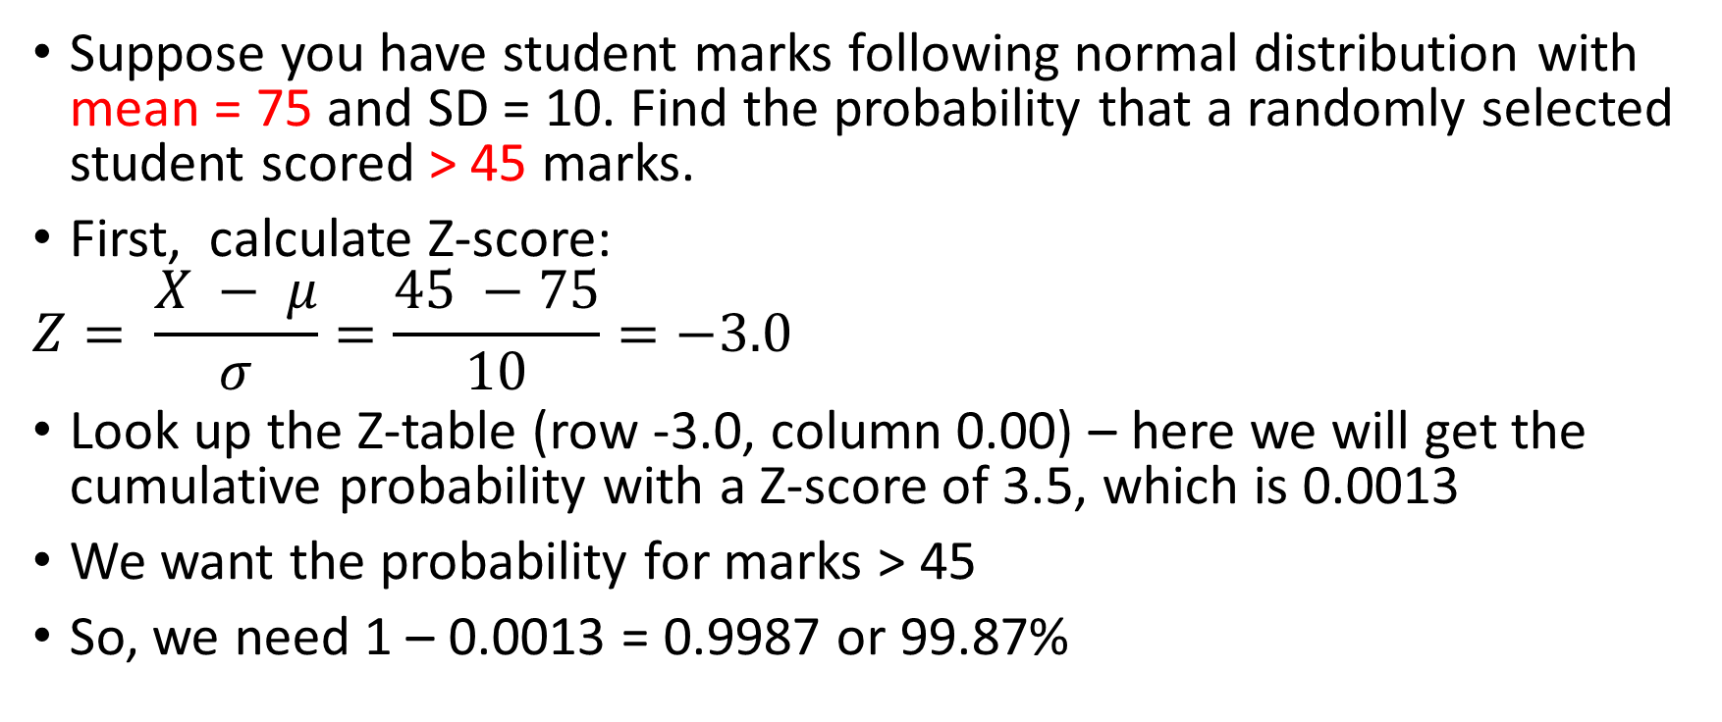
Z-table: Case 4
Suppose you have student marks following normal distribution with mean = 75 and SD = 10. Find the probability that a randomly selected student scored > 45 marks.
First, calculate Z-score:
$$Z= \frac{X − μ}{σ}=\frac{45 −75}{10}=−3.0$$
Look up the Z-table (row -3.0, column 0.00) – here we will get the cumulative probability with a Z-score of 3.5, which is 0.0013
We want the probability for marks > 45
So, we need 1 – 0.0013 = 0.9987 or 99.87%

Slide 40
QQ Plot
QQ Plot = Helps us determine if given data is normally distributed or not
Q = Quintile
Quintile divides a dataset into five equal parts: Q1 (Lowest 20% of the data) to Q5 (Highest 20% of the data)
Confusion: The QQ plot is not based on quintiles – then why is it called QQ plot?
Earlier, in the absence of computers, the QQ plot was drawn using the two quartiles Q1 and Q3 – hence the name QQ
Plots theoretical (expected) data points in the form of a line and the actual (observed) data points as points related to the line
Theoretical data is a straight line, as per the normal distribution

Slide 41
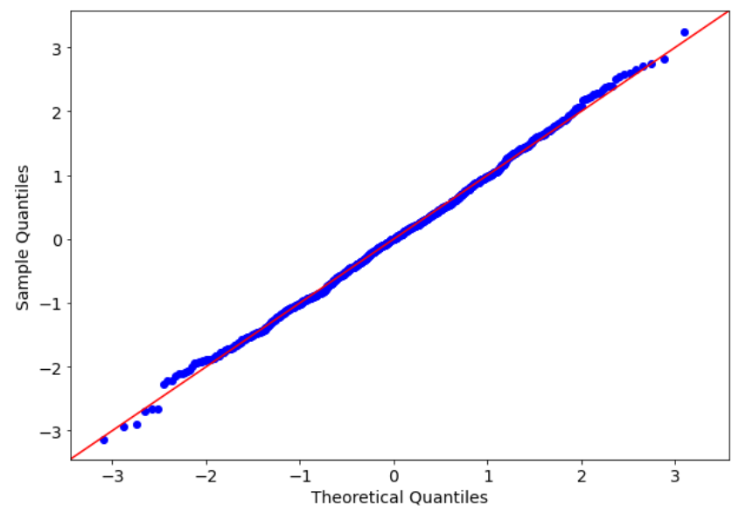
QQ Plot Example

Slide 42
Correlation

Slide 43
Correlation
Correlation: Are two variables related?
Examples: Exercise and Health, Study and Marks, Experience and Salary
Measured using correlation coefficient (r)
Pearson Correlation Coefficient: Measures linear relationships between continuous variables
Spearman Rank Correlation Coefficient: Measures relationships, even if they are not strictly linear

Slide 44
Correlation Interpretation
Range is -1 to +1
Positive correlation: Variables move up together
Example: Correlation of 0.80 between Hours spent studying and test scores
Negative correlation: As one variable moves up, the other moves down
Example: Correlation of -0.70 between Hours spent watching TV and physical fitness
Zero correlation: Variables are unrelated
Example: Correlation of 0.02 between Shoe size and IQ score

Slide 45
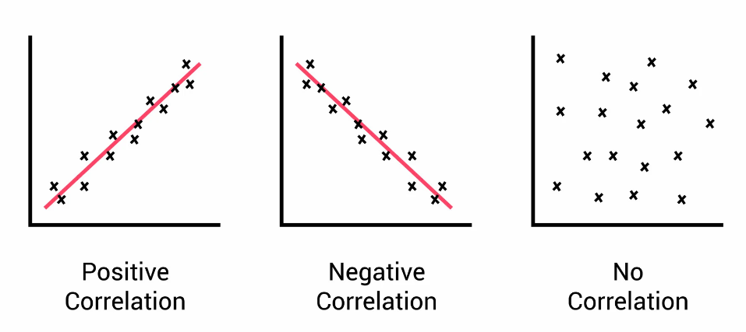
Positive, Negative, No Correlation

Slide 46
Key Point about Correlation
Plotting the correlation between two completely different variables, such as age and income, may not provide meaningful insights because correlation is typically used to measure the strength and direction of the linear relationship between two continuous variables
In the case of age and income, these variables serve different purposes, their scales are different (Years, Dollars) and may not have a straightforward linear relationship
But if we plot correlation between say Marks in Science and Marks in Maths, it makes a lot of sense, because we are talking about a similar scale and purpose
(See C:\code\Data Analytics\correlation-outliers-bad-example.py later)

Slide 47
Covariance

Slide 48
Covariance
Covariance quantifies how changes in one variable relate to changes in another
Scale of covariance is in the units of what we are measuring (difficult to interpret), whereas correlation is always between -1 and +1 (easy)
Useful when units of measurement and scale are important
Example: Are temperature and rainfall related?
Correlation: Will give a value between -1 and +1, say 0.5 (Says Moderate)
Covariance: For every 1 degree increase in temperature, rainfall decreases by 5 mm (Says How much?)

